Slide 1


AWS SOLUTIONS ARCHITECT ASSOCIATE
Module 5:
Load Balancing, Amazon CloudWatch & Auto Scaling

Slide 2
Module Overview
Elastic Load Balancing
Amazon CloudWatch
Auto Scaling

Slide 3

Lesson 01: Elastic Load Balancing

Slide 4
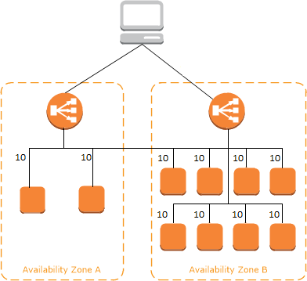

Elastic Load Balancing
Used to distribute traffic across a group of Amazon EC2 instances in one or more Availability Zones to achieve greater levels of fault tolerance for your applications.
Elastic Load Balancing

Slide 5

Elastic Load Balancing
Type of Load Balancers
  Internet-Facing Load Balancers
  Internal Load Balancers
  HTTPS Load Balancers
Listeners & Protocols
  HTTP
  HTTPS
  TCP
  SSL
Elastic Load Balancing
Classic Load Balancer

Slide 6
Lesson 02: Amazon CloudWatch

Slide 7
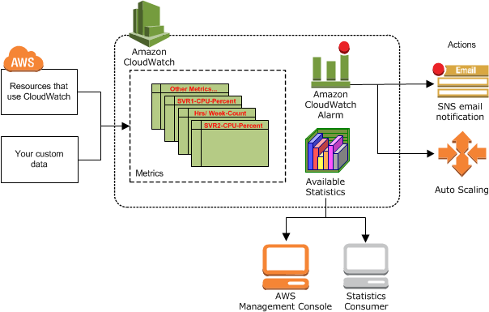

Amazon CloudWatch
Monitoring resources and applications. Amazon CloudWatch is used to collect and track metrics, create alarms that send notifications, and make
changes to resources being monitored based on rules you define.
Amazon CloudWatch

Slide 8
Amazon CloudWatch
Amazon CloudWatch Monitoring
  Auto Scaling
  Amazon CloudFront
  Amazon CloudSearch
  Amazon DynamoDB
  Amazon EC2
  Amazon EC2 Container Service
  Amazon ElastiCache
  Amazon EBS
Amazon CloudWatch

Slide 9
Amazon CloudWatch
Amazon CloudWatch Monitoring
  Elastic Load Balancing
  Amazon Elastic MapReduce
  Amazon Elasticsearch Service
  Amazon Kinesis Streams
  Amazon Kinesis Firehose
  AWS Lambda
  Amazon Machine Learning
  AWS OpsWorks
Amazon CloudWatch

Slide 10
Lesson 3: Auto Scaling

Slide 11
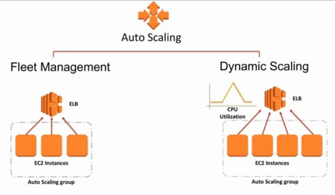
Auto Scaling
Allows you to automatically scale your Amazon EC2 capacity out and in using criteria that you define.

Slide 12

Auto Scaling
Auto Scaling Plans
  Maintain Current Instance Levels
  Manual Scaling
  Scheduled Scaling
  Dynamic Scaling
Auto Scaling Components
  Launch Configuration
  Auto Scaling Group
  Scaling Policy
Auto Scaling

Slide 13
Lab Module 5

Slide 14


Auto Scaling Workflow
Elastic LB
WEBLB02
VPC01
10.0.0.0/16
Auto Scaling
Launch
Configuration
Instances
VPC01-PubSNet01
10.0.0.0/24
VPC01-PubSNet01
10.0.3.0/24
VPC01-SNet01
10.0.1.0/24
VPC01-SNet01
10.0.2.0/24
us-west-2a
us-west-2b
Win2019Image

